Slide 1
ICT
Information and Communication Technologies

Slide 2
What Is ICT?

Slide 3

A broad term encompassing technologies that facilitate the collection, processing, storage, and exchange of information. ICT includes computer systems, networks, software, and communication devices, shaping the way we access, manage, and share data in the digital age.
ICT
(Information and Communication Technology)

Slide 4

There are many applications and companies that provide these services

Slide 5





Offers applications like Google Docs, Sheets, and Slides for collaborative online document creation and editing, like: Gmail: Google's free email service, known for its user-friendly interface, ample storage, and seamless integration with other Google tools. Google Drive: Cloud storage by Google for storing, sharing, and collaborating on files online. Google Sheets: A web-based spreadsheet application by Google, enabling users to create, edit, and collaborate on spreadsheets in real-time, accessible from various devices. Google Sites: A user-friendly website creation tool by Google, allowing individuals and organizations to build and share websites without the need for coding skills.
GOOGLE SUITE

Slide 6
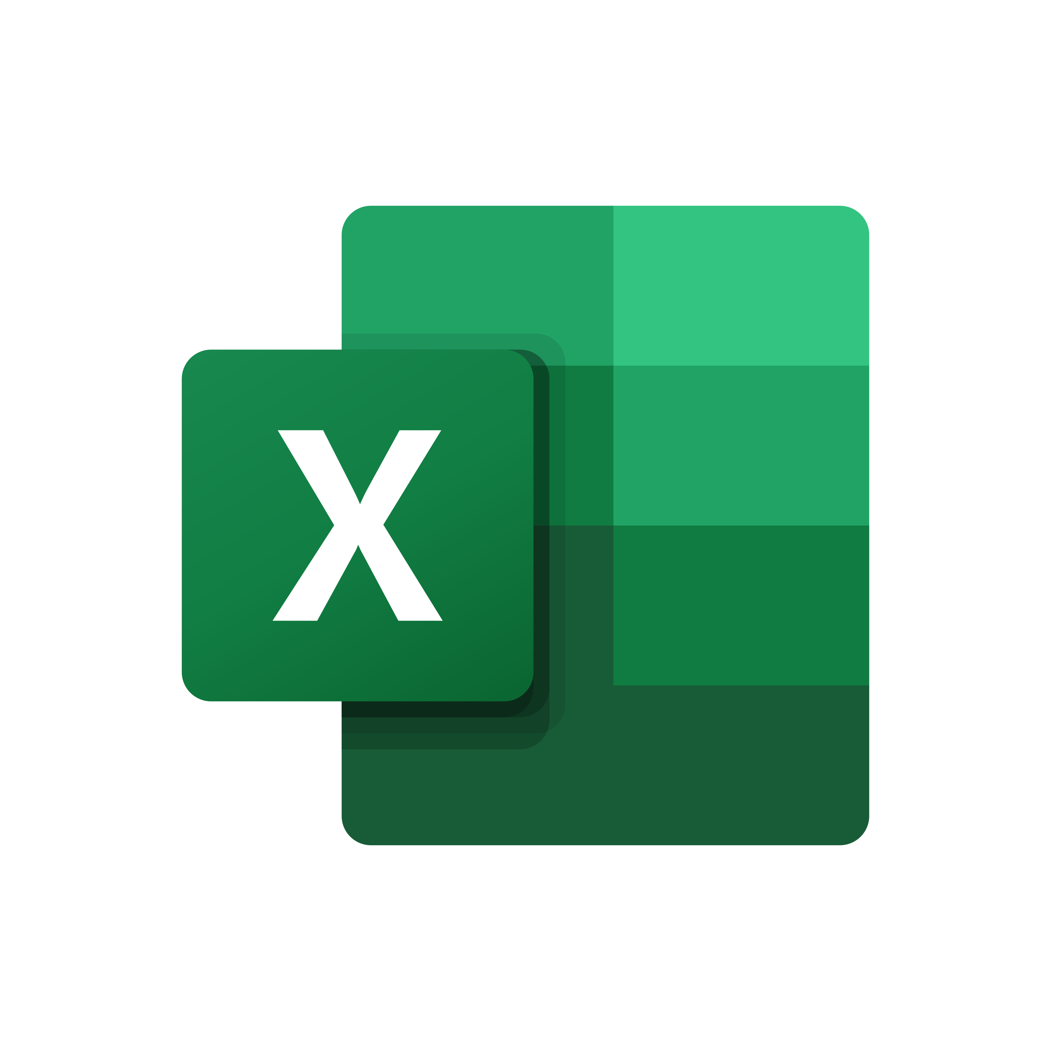




Microsoft Office Suite
Includes software like Word, Excel, and PowerPoint for document creation, data analysis, and presentations:
Word:
Microsoft Word is a word processing software that allows users to create and edit documents, making it widely used for writing, formatting, and sharing text-based files.
Excel:
Microsoft Excel is a spreadsheet application designed for organizing, analyzing, and visualizing data through the creation of tables, charts, and graphs.
PowerPoint:
Microsoft PowerPoint is a presentation software that enables users to create slideshows with text, images, and multimedia elements, making it a popular tool for business presentations and educational purposes.
Outlook:
Microsoft Outlook is an email client and personal information manager, widely used for managing emails, calendars, contacts, and tasks in a unified interface.

Slide 7


GIT
Git is a distributed version control system designed for tracking changes in source code during software development. It enables collaboration among developers, providing a history of revisions and facilitating team coordination.
GITHUB
Git is a distributed version control system designed for tracking changes in source code during software development. It enables collaboration among developers, providing a history of revisions and facilitating team coordination.

Slide 8

ICT
is still constantly evolving and with the passage of time. Whether by updates or by issuing new tools and applications
Past | 2016 | 2019 | 2022 | Today | 2025 | 2030 | Future
New Updates New Applications New Services

Slide 9
End
Made by:
Benayache Ahmed Yacine
Taleb Idriss
Yalaoui Mohamed Amine
Maten Anis
Halimi Anes

